Slide 1


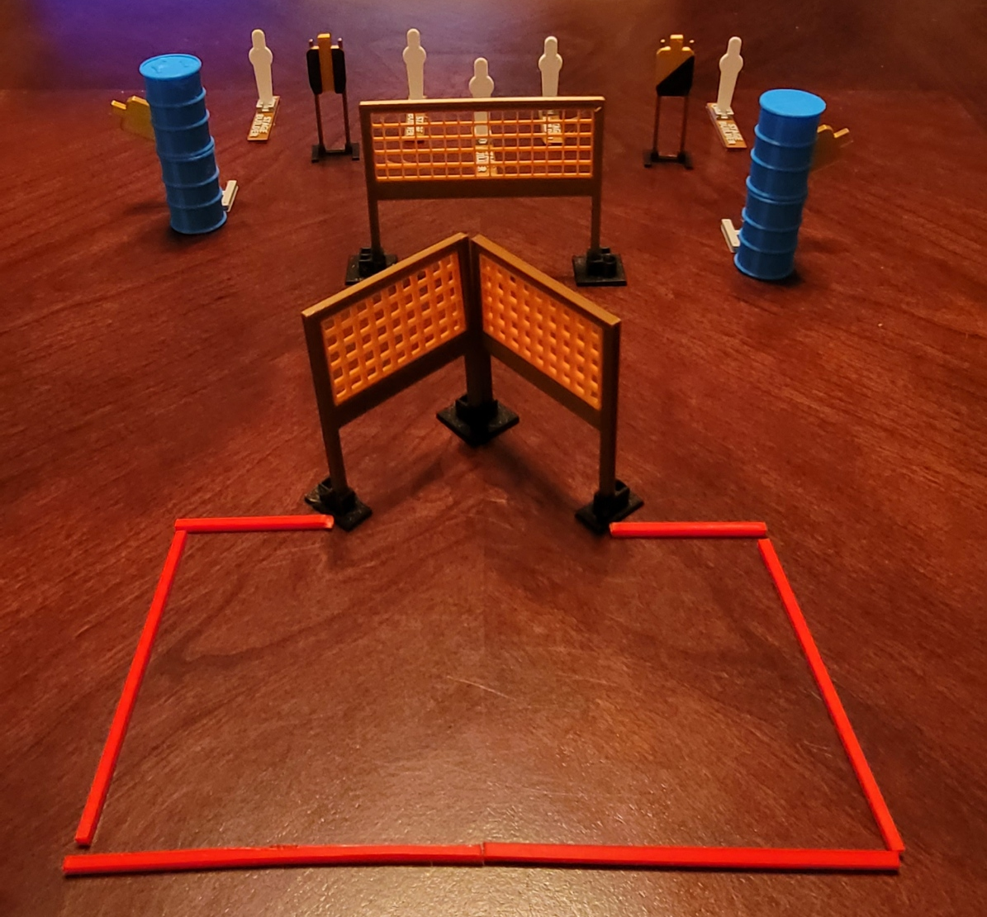
 | Dothan Gun Club – USPSA Match Gotta Go For Four Course Designer : Drew Coleman Bay: A1
Round Count 13 rounds 4 USPSA 5 colt poppers
Equipment List 5 wall feet 2 swingers + activators 1 tux, 1 right diag 2 targets

Slide 2
Gotta Go For Four
Written Stage Briefing
Scoring: Comstock Rounds: 13
Targets: 4 USPSA, 5 steel
Handgun start position: anywhere completely outside the shooting area, wrists below belt. Handgun is loaded and holstered.
PCC start position: anywhere completely outside the shooting area, stock on belt. Loaded carbine is held with both hands, safety on.
Stage Procedure: on the audible start signal, engage targets as they become available from within the shooting area.
Swingers are activated by poppers and remain visible at rest.

